Slide 1
AI Challenge: Collecting and Curating Data with People and Communities
Dr Jessica Korte
Notes:
Collecting labelled data is not easy, and you have to engage with content experts/communities
Put technical stuff first

Slide 2
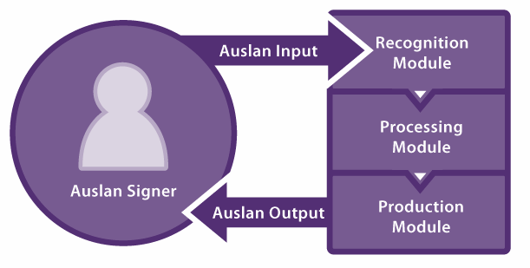
A bit about Jessica
Background:
Human-centred computing
Participatory design
Design with Deaf children
Currently:
TAS DCRC Fellow
Developing AI-based sign language technologies
Working with Deaf people to determine directions
Defence funding

Slide 3
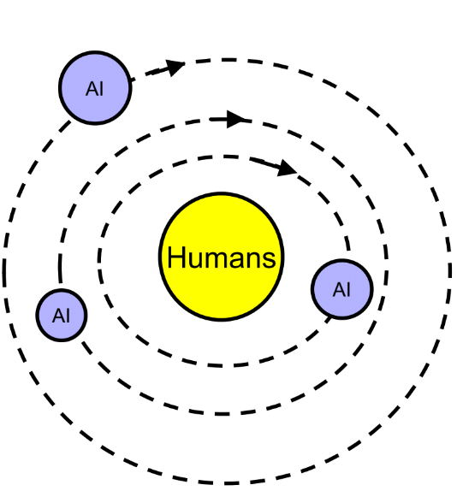
Human-Centred AI
AI is often created:
Using data generated by people
For use by people
To support people in achieving some goal
Therefore, it should be designed and developed in a way that supports people:
Amplify, augment, enhance, empower
Reliable, safe, trustworthy, understandable
Human self-efficacy, creativity & responsibility
Human values, rights & dignity
Ben Shneiderman. (2020). Human-Centred AI. Opening Keynote, OzCHI 2020. https://www.youtube.com/watch?v=4GTk_QqCA-I&feature=youtu.be&ab_channel=ozchiconf

Slide 4
Collecting and coding data for sign language technologies

Slide 5
Step 1: Understand the data
❌ “be fluent in Auslan”
❌ be a domain expert
✔ Understand the components of Auslan
✔ Understand how it is used by signers
✔ Understand how information about it can be recorded
Ensures data can be collected, coded and used:
Respectfully
Productively
Usefully
“The solutions proposed by signed language recognition and other similar technologies (e.g. signed language gloves, avatars) are generally not feasible, because they are… based on naïve understandings of what deaf community signed languages are and how they work, or even the realistic needs and desires of deaf and hard of hearing signers striving for improved communication access.”
- Dr Gabrielle Hodge, Deaf academic, UCL

Slide 6
What are sign languages?
Natural languages
Full expressive languages
NOT international
Multi-channel
Multidirectional
NOT the same as spoken languages
Not usually acquired from parents
Visible at a distance
NOT “sign systems”
Used by Deaf people
But not just by Deaf perople
NOT “just miming”
NOT just letter signs

Slide 7
Sign vs Gesture
Sign: Formal language component (“Lexical”, “Conventionalised”)
Gesture: Informal, non-language, but might support communication
But also:
Parly-lexical signs: “combinations of conventional and non-conventional (highly contextual) elements” [1]
Depicting/classifier signs
Indexing/pointing signs
Motion-modified verbs
But also:
Non-lexical signs: “essentially gestures that appear to have no language-specific conventionalized form/meaning pairing of their own….
Gestures rely on context to be construed as signs and to be correctly interpreted….” [1]
[1] Johnston, T. 2016. Auslan Corpus Annotation Guidelines. http://media.auslan.org.au/attachments/Auslan_Corpus_Annotation_Guidelines_November2016.pdf

Slide 8
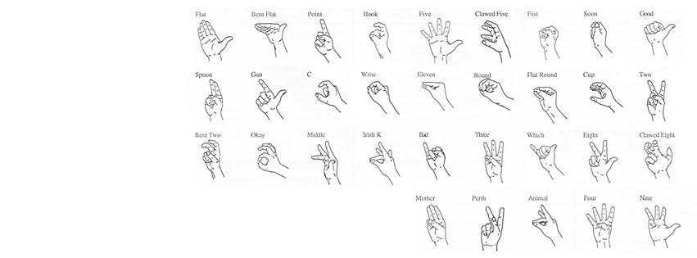
What makes a sign (linguistically)?
Handshape
Orientation
Location
Movement
Expression (Non-manual features)
Image modified from: Parker, D., & Schembri, A. (1996). Technical Signs for Computer Terms. North Rocks, New South Wales: North Rocks Press, Royal Institute for Deaf and Blind Children.

Slide 9
 | FUNNY (strange) | FUNNY (amusing) | SISTER | COME | WORM / CATERPILLAR Two-handed sign |  | SHAVE / RAZOR | WATER (Southern)
Handshape | Hook | Hook | Hook | Hook | Hook | Flat / Five / Fist / - | Hook * Classifier handshape | Hook
Orientation | Palm front | Palm front | Palm to non- dominant side | Palm up | Palm down | Palm down | Palm front | Palm front
Location | Cheek (dominant) | Cheek (dominant) | Nose | In front of body * Varies depending on use | In front of body (on top of non- dominant arm) | In front of body | Cheek (dominant) | Cheek (dominant)
Movement | “tapping” | “tapping” | “tapping” | Towards signer | Right / left + Hooking | - | Down | Repeated down
Expression | Frown | Smile / laugh | - | - | - | - | Mouthing English word | -

Slide 10
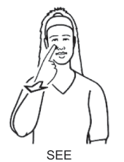
“Writing” sign languages
“SLs are face-to-face visual-gestural languages that have no widely accepted written forms or standardized specialist notation system that can be used to represent what is being uttered.” [1]
Drawings annotated with arrows and phase numbers
Video recordings
English translation
Glossing: capture meaning on a sign-by-sign basis
HamNoSys (Hamburg Sign Language Notation System): symbol-based, HOLME elements
HamNoSys has an XML markup, SigML
SignWriting: symbol-based, “movement based”, developed for ASL
Used by linguists in the Auslan Corpus
[1] Johnston, T. 2016. Auslan Corpus Annotation Guidelines. http://media.auslan.org.au/attachments/Auslan_Corpus_Annotation_Guidelines_November2016.pdf
Image source: Johnston, T. 2018. A corpus-based study of the role of headshaking in negation in Auslan (Australian Sign Language): Implications for signed language typology. Linguistic Typology. 22, 2 (2018), 185–231. DOI:https://doi.org/10.1515/lingty-2018-0008.

Slide 11
Step 2. Collect the Data

Slide 12
Technical Considerations for Datasets
Multi-channel data
Hands, body, facial expression, mouthing
Data format
Video
Depth
Poses/skeleton
Some other way of capturing shape / positions / movement of hands, body, face
Variation in production
Inter-signer variation
Dialects & accents
→ Where possible, repetition of signs by multiple signers
Varied lexicality
Semi-lexical signing: situational use of space
Non-lexical signs: “enactment”
Heavily inferential:
Meaningful use of space
Indexed locations
Eye gaze
Conversation repair

Slide 13
Data Collection Considerations
Who are you collecting data from?
Native Deaf signers?
Fluent sign
Real-world use
Live Deaf culture, norms
Interpreters?
May not be native signers
Likely to be influenced by spoken language grammar
Learner signers?
High potential to “get it wrong”
Not necessarily aware of Deaf culture, norms
Not recommended generally [4]
How to get buy-in from Deaf signers?
Work on projects that matter to Deaf community
Involve Deaf people at all stages of project, especially:
Planning
Design
Data collection
Data coding
Verification
End user evaluation
Collect data that is significant, meaningful and/or useful to the Deaf community
Ask them!
[4] Lynn Hou, Ryan Lepic & Erin Wilkinson. Working with ASL Internet Data. Sign Language Studies, Volume 21, Number 1, Fall 2020, pp. 32-67 (Article). Gallaudet University Press. https://doi.org/10.1353/sls.2020.0028

Slide 14
Data Collection Considerations
How do you elicit signing?
Role playing scenarios
E.g. “What instructions would you want to give Alexa?”
Conversations
Within or across dialects?
Within or across cultural/racial groups?
Re-telling stories
Interpret/translate
May result in English-like grammar or other artefacts
Copying existing videos
Possibly for learners
Where possible, collection should be undertaken in a Deaf-only environment.
Who owns the data, and how can it be used?
Who can code data?
Only fluent signers should provide translations, glosses, meanings of certain non-manual features
Non-signers may be able to identify some HOLME components

Slide 15
Existing sign language dataset examples
Auslan ELAR Dataset
Native signers
Video, incomplete annotations (diverse layers)
Contains personally identifiable, sensitive information
RWTH-PHOENIX-Weather 2014 T
German sign language DGS
Interpreters
Video, glosses, German translations
Weather
American Sign Language Lexicon Video Dataset (ASLLVD)
Native and learner signers
Isolated signs, multiple views
Videos, glosses
Australian Sign Language signs Data Set
Raw measurements from Nintendo PowerGlove
"cheap and nasty"
Mix of native, learner and interpreters
WLASL
ASL
Videos, glosses?
Details of signers’ proficiency not supplied
Human Communication: an Audio-Visual Archive (CAVA)
BSL
Native signers
Conversations
Videos, some translations & annotations
BSL-1K Dataset
Interpreters
“weakly-aligned subtitles”
Public DGS Corpus
Video, German & English translations, glosses, mouthings
Implied to be native signers, possibly also interpreters
YouTube?
Various sign languages
Not always clear if signers native/fluent → Many hearing/learner signers post videos
No explicit agreement for use in ML

Slide 16
Step 3. Code the Data
Must be appropriate for the data and the planned use.
Ideally, this should be done / verified by domain experts (i.e. fluent signers)
No natural written form (Machine readability requires written encoding)
Different grammar from English → direct translation may not be useful
Code
Label
Annotate
Ground truth
Mask

Slide 17
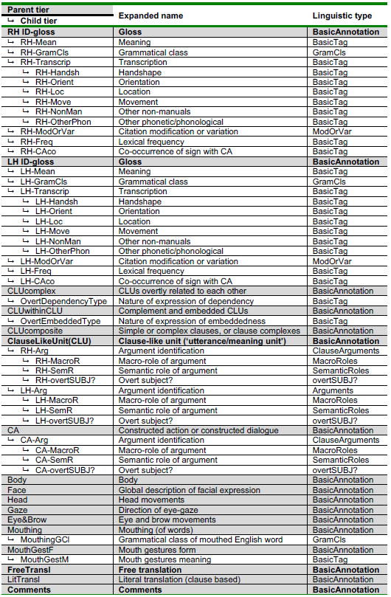
Coding sign language data
Linguist’s approach [1]
[1] Johnston, T. 2016. Auslan Corpus Annotation Guidelines. http://media.auslan.org.au/attachments/Auslan_Corpus_Annotation_Guidelines_November2016.pdf

Slide 18
Annotation Tiers at a glance
RH-IDgloss* | Right hand sign gloss, CV
└ RH-Transcrip | Right hand transcription – HamNoSys or left blank
└ RH-Handsh | Right hand handshape, CV
└ RH-Orient-cp | Right hand orientation, CV
└ RH-Loc | Right hand location, CV
└ RH-PathMove | Right hand path movement, CV
└ RH-SecMove | Right hand secondary movement, CV
LH-IDgloss* | Left hand sign gloss, CV
└ LH-Transcrip | Left hand transcription – HamNoSys or left blank
└ LH-Handsh | Left hand handshape, CV
└ LH-Orient-cp | Left hand orientation, CV
└ LH-Loc | Left hand location, CV
└ LH-PathMove | Left hand path movement, CV
└ LH-SecMove | Left hand secondary movement, CV
Mouthing | Mouthing of whole/partial English words
MouthGestF | Mouth gesture form, CV
MouthGestM | Mouth gesture meaning, CV
Eye&Brow | Eye and eyebrow movements
Head | Head movements
Body | Body movements
Gaze | Eye gaze target
FreeTransl* | Free translation
LitTransl* | Literal translation
Comments | Comments
* This tier should only be coded by fluent signers.
└ indicates a child tier, which is dependent on its parent tier for timing segmentation.

Slide 19
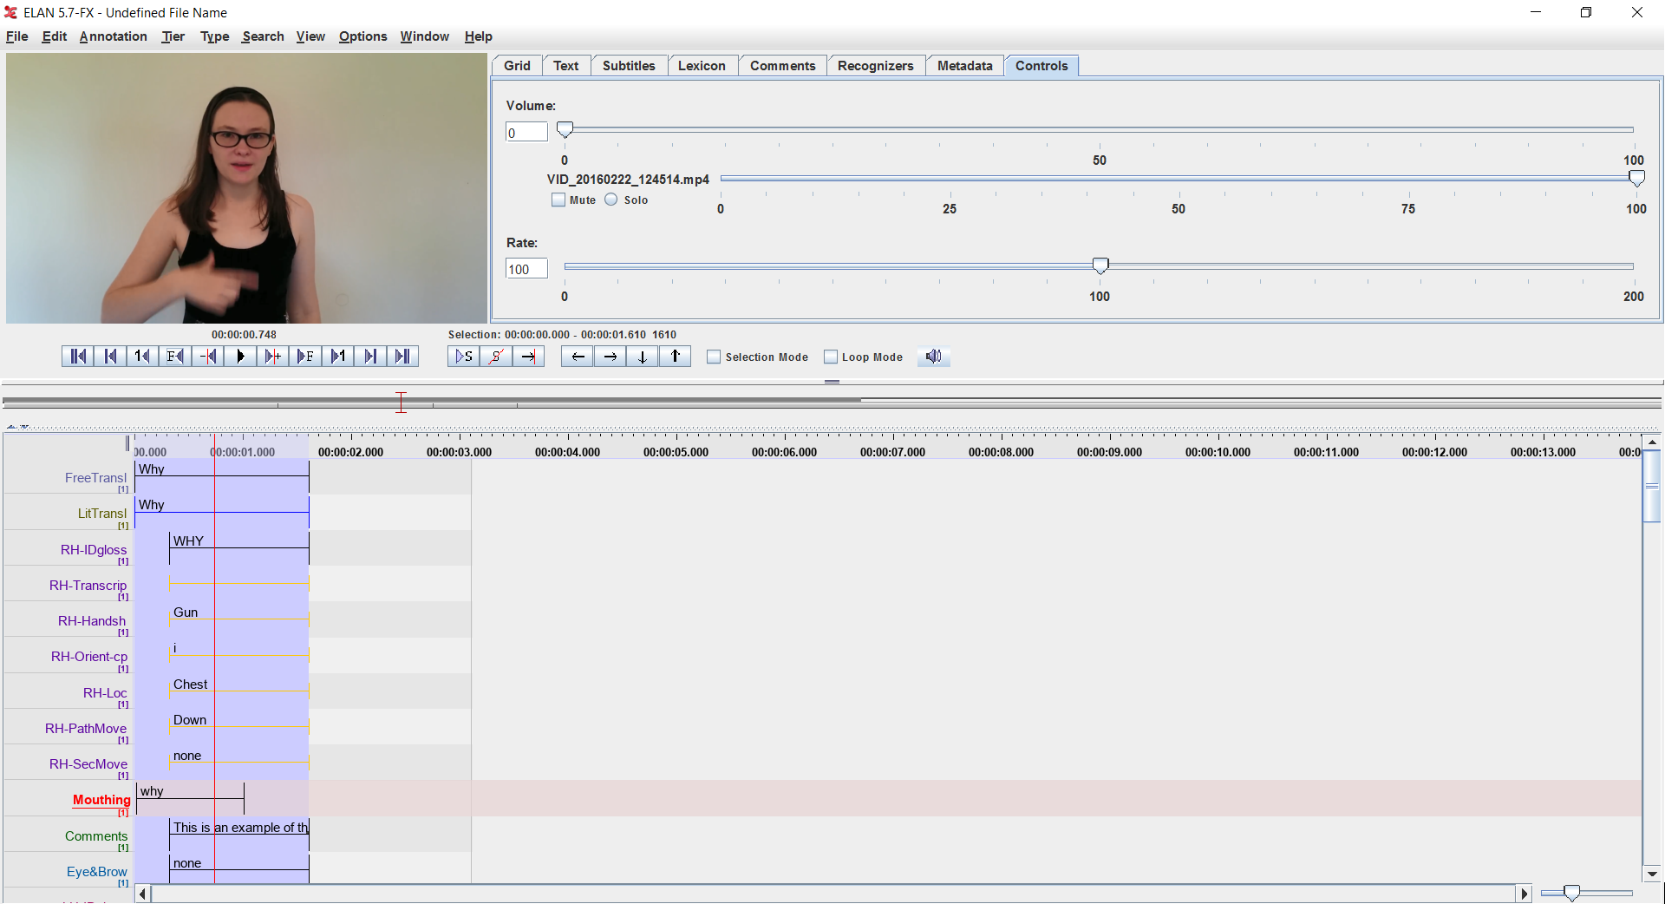
Format of coded Auslan data
Sign data: Video (.mp3)
Coding program: Elan (.eaf), xml
Gloss source: Auslan Signbank

Slide 20

Consistency matters!
If necessary, create coding guidelines and limited vocabularies to ensure consistency among multiple coders.

Slide 21
Step 4. Use the Data
The data you collected should have been informed by the intended uses.
The intended uses should have been informed by the needs and desires of the community you are collecting data from.
Medical data → giving doctors more / better information to make diagnoses & inform treatments
Auslan data → Siri for sign language?

Slide 22
Researchers have responsibilities to communities
Learn:
Language
Community & cultural norms
Needs & desires
New technologies should address the needs and desires of communities
Data collected should be significant, meaningful and/or useful to communities
Reciprocity: What can be given back?
Pay domain (language) experts for their expertise
Hire from within the community
Upskill people within the community
Can devices / technologies be left in the community?
If they need ongoing support, can community members be upskilled to provide that support?
Full & honest disclosure:
Who is funding the project?
What are the goals of the project?
How will data be stored, used, published?
How will new technologies be used?
If community members don’t want to work with you after full disclosure, there is something wrong with your project.
Community involvement: where and how should community members be involved in a project?
Planning
Design
Data collection
Data coding
Verification
End user evaluation
Community members have knowledge and perspectives that you lack. They will have ideas that you’ve never had – and that can improve a project.

Slide 23
Thank you
Questions?

Slide 24
Australian Deaf Culture
Signing: Auslan
Sport
Cultural involvement
Gatherings
Conferences
Festivals
Clubs
Cultural Deaf ≠ medically deaf
CODAs
deaf children of hearing parents
[20]
Signed communication has different conventions and cues than spoken communication
Visual attention [20]
Waving
Light touch
Tapping / stamping to cause vibration
Maintain throughout conversation [39]
Freeze-look [2]
Body language [20,35,39]
Facial expression / movements [20,35,39]
[2] Manrique E. & Enfield N. J. 2015. Suspending the next turn as a form of repair initiation: Evidence from Argentine Sign Language. Front. Psychol. 6:1326. doi: 10.3389/fpsyg.2015.01326
[20] Johnston, T. and Schembri, A. 2007. Australian Sign Language (Auslan): An Introduction to Sign Language Linguistics. Cambridge University Press.
[35] Saville-Troike, M. 2003. The ethnography of communication, an introduction. Blackwell.
[39] vicdeaf 2010. Deaf culture & communication: A basic guide. Victorian Deaf Society. https://www.expression.com.au/files/editor_upload/File/Information%20Sheets/Deaf%20Culture%20and%20Communication%20-%20A%20Basic%20Guide.pdf

Slide 25
Auslan CTP: Principles of Community Engagement
Onus is on researchers to learn
Language, community norms, culture
Openness and honesty
Military funding
Recruiting
Recruitment information provided in Auslan and English
Contacting Deaf organisations around the country as start point
Project Advisory Board of Deaf people
Advertising all positions (not just “data sources”) in Deaf community spaces
Paying Deaf people for their involvement and expertise
Collect new dataset in collaboration with Deaf community, with intention of making it available
All contributors aware of access at data collection - able to choose own level of comfort for data contributions
Licensing enabling use for ML, educational purposes
Registration for access, to track who has the data
Scope
In consultation with Project Advisory Board
Wider consultation with Deaf community?
Proposed: “Siri for sign language” - based on public calls by Deaf people

Slide 26
How to create good sign language technologies

Slide 27
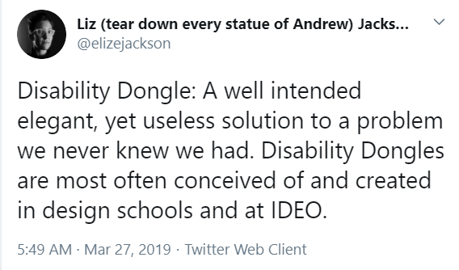
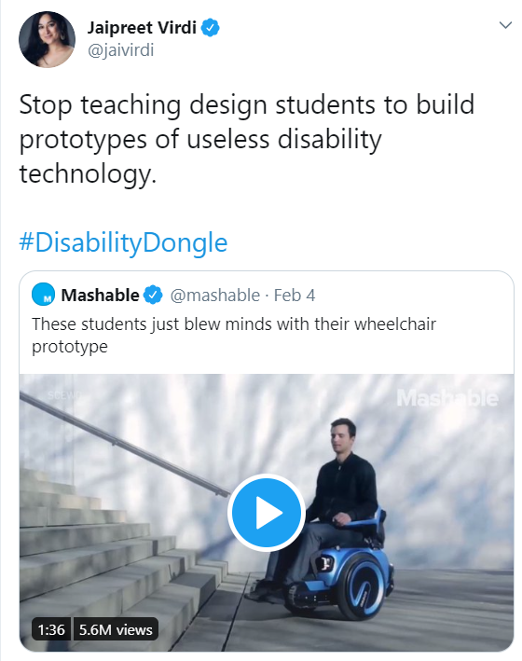
Disability Dongle
Technologies created “for” disabled* people, based on abled people’s (uninformed) perception of what is a problem.
* The terms “disabled people” ** and “abled people” are used here in recognition that it is a society’s unwillingness to accommodate a range of abilities which disables people. “Disability” is not an inherent characteristic of a person.
** “Deaf people consider themselves as a linguistic and cultural group, with highly complex natural languages but the rights of deaf people are however assured through disability policy, legislation and international instruments.” _{[3]}
[3] https://wfdeaf.org/news/resources/wfd-position-paper-complementary-diametrically-opposed-situating-deaf-communities-within-disability-vs-cultural-linguistic-minority-constructs/
Upper tweet: https://twitter.com/elizejackson/status/1110629818234818570
Lower tweet: https://twitter.com/jaivirdi/status/1224453297047662599

Slide 28
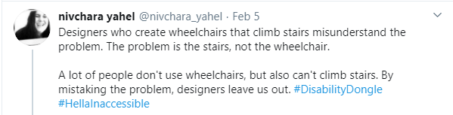
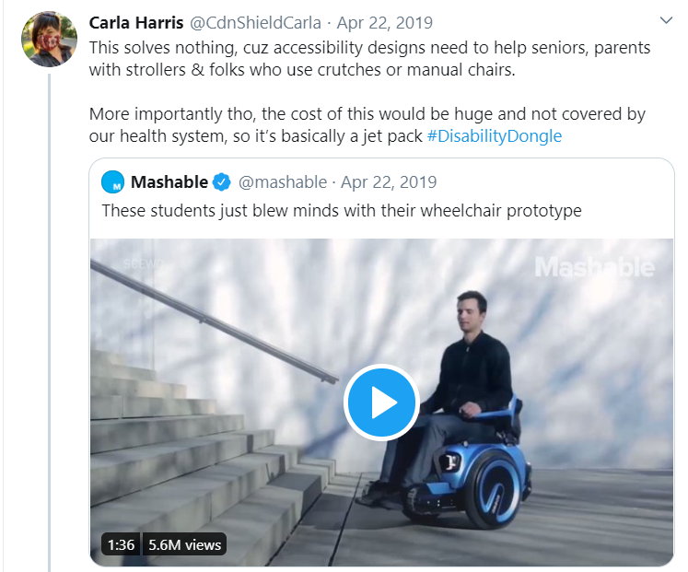
How to make good tech instead
Listen to your prospective users.
Work with end users in your projects, especially disabled people and people from cultural and linguistic minorities.
Work on projects disabled people want worked on.
Left tweet: https://twitter.com/nivchara_yahel/status/1224914103711543297
Right tweet: https://twitter.com/CdnShieldCarla/status/1308329194200297474

Slide 29
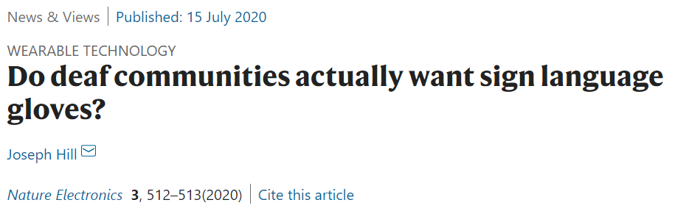
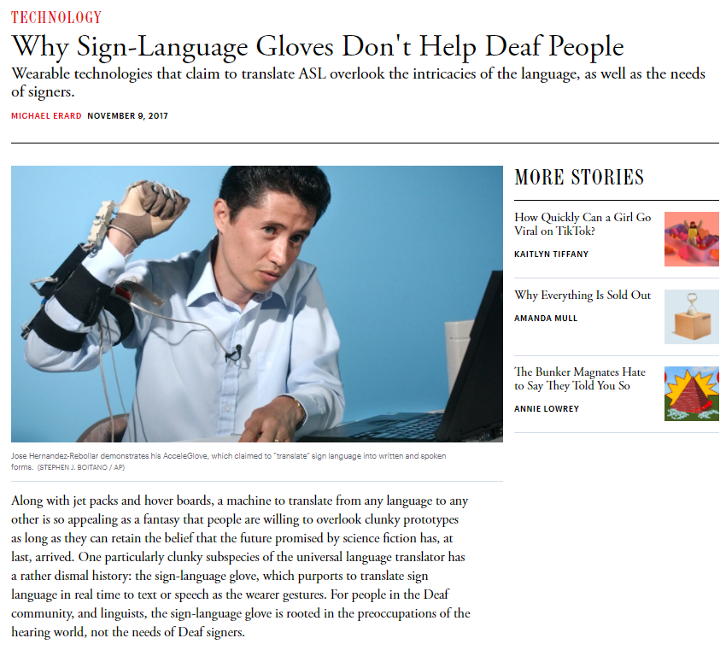
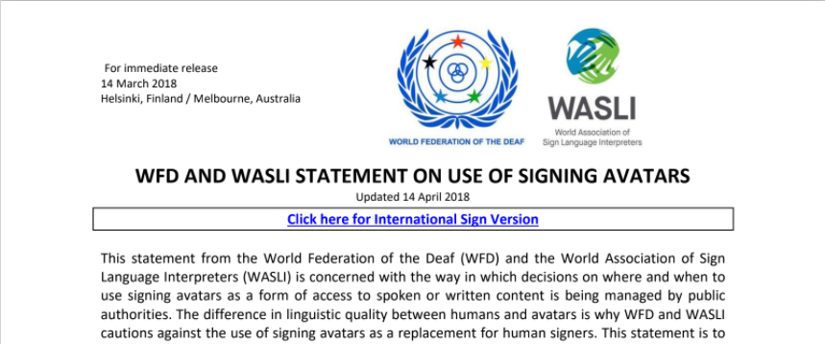
Sign language technologies are often disability dongles
Deaf people, other signers and advocates spend a lot of time and energy pushing back.
Upper: https://www.nature.com/articles/s41928-020-0451-7
Middle: https://www.theatlantic.com/technology/archive/2017/11/why-sign-language-gloves-dont-help-deaf-people/545441/
Lower: https://wfdeaf.org/news/resources/wfd-wasli-statement-use-signing-avatars/

Slide 30
Working with the Deaf community

Slide 31
Requirements and questions for sign language technologies
Part 4

Slide 32
Requirements for Sign Recognition & Related Problems
Detect signing | With increased video conferencing, this is a major question. Some applications exist in this space, e.g. Apple FaceTime sign detection, Google demo app for highlighting signers
Is a movement a sign or a gesture?
If multiple people are in view, who is signing?
Identify/classify signs
Whole signs? | This is a more traditional CV/ML approach.
From sign components? | This approach may allow for more robustness, but be more computationally heavy.
Identify meaning | Auslan grammar is very different from English, so depending on your application, this may not be useful. Context matters: Some signs’ meanings are altered by context, both within conversation and in larger context.
Individual signs?
Clauses? Sentences? | This is likely to be useful in more contexts, but is more complex.

Slide 33
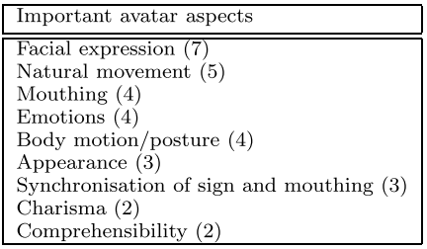
Requirements for Computer-Generated Sign Production
Clarity, accuracy & fluidity of:
Handshape
Hand orientation
Hand location
Movement
Facial expressions / movements
Body language
Sufficiently detailed encoding to generate signs
Not cause reputational issues | Relevant to GAN and DeepFakes video generation
Context-appropriate style | e.g. not cartoonish for medical or legal contexts
Table source: Kipp, M. et al. 2011. Assessing the Deaf User Perspective on Sign Language Avatars. The Proceedings of the 13th International ACM SIGACCESS Conference on Computers and Accessibility (Dundee, Scotland, UK, 2011), 107–114.

Slide 34
Questions for Sign Language Processing
How well can existing NLP approaches be converted to work in SLP?
How to symbolise signs when there is no native written equivalent? | Some sign notation systems have been developed, but none are used by communities. Translation/glossing involves moving data into a second language.
Can the use of a video dataset reduce the need for written notation in SLP?
How to identify and process less conventionalised signed communication, such as enactment?
Can and should sentiment analysis inform SLP and sign production?

Slide 35
Criticisms of technologies so far
Lack of understanding of sign languages
Focusing on static, lexical signs (often letters, numbers)
Limited consideration of semi-lexical signs
No consideration of non-lexical signing
Signed communication may be context-heavy and require “listener” to do “heavy lifting” of inference - something computers are not good at _{[3]}
Treating sign recognition as a gesture recognition problem, not a language problem
Limited use of BLEU
Unrealistic limitations on context of use
Limited backgrounds
Skin colour recognition
Proving diversity of skin tones captured
Gloves / wearables not realistic for daily use
All the Disability Dongle problems already discussed
[3] LaPolla, R. 2003. Why languages differ: Variation in the conventionalization of constraints on inference. In Bradley, D., Lapolla, R., Michailovsky, B. and Thurgood, G. editors, Language variation: Papers on variation and change in the Sinosphere and in the Indospherein honour of James A. Matisoff. DOI:10.15144/PL-555.113

Slide 36
Potential Computational Approaches
 | Handshape / orientation | Hand location | Hand movement | Expression / facial movement | Single sign recognition | Continuous sign recognition
Image / video processing | X | X | X | X | X | X
Pose estimation | Possible | X | X | Possible | X | X
Skin colour differentiation | X |  |  |  | X | X
Hand segmentation | X |  |  |  | X | X
Face detection |  |  |  | Possible | Possible | Possible
Automatic segmentation |  |  |  |  | X | X
Optical flow |  |  | X
Motion history |  |  | X |  | Possible
Frame difference |  |  | X
CNN | Possible | Possible |  |  | X | X
RNN |  |  |  |  | Possible | Possible
LSTM |  |  |  |  | Possible | Possible
Depth | Limited | X
HMM |  |  |  |  | X | X
Transformers |  |  |  |  |  | Need to encode signs
Multimodal |  |  |  |  | X | X
Lip reading |  |  |  | X
Expression recognition |  |  |  |  | X | X
Entropy-based AI | Possible | Possible | Possible | Possible | Possible | Possible
Few-shot learning |  |  |  |  | Possible
Zero-shot learning |  |  |  |  | Possible

Slide 37
Potential Computational Approaches: Bibliography
Borg, M., Camilleri, K.P.: Sign language detection “in the wild” with recurrent neural networks. In: ICASSP 2019-2019 IEEE International Conference on Acoustics, Speech and Signal Processing (ICASSP). pp. 1637–1641. IEEE (2019) https://mark-borg.github.io/papers/icassp_mb.pdf
H. Bull, et al., “Automatic Segmentation of Sign Language into Subtitle-Units”, In SLRTP Workshop, ECCV 2020. https://slrtp.com/papers/full_papers/SLRTP.FP.01.011.paper.pdf
E. J. E. Cardenas, G. C. Chavez, “Multimodal hand gesture recognition combining temporal and pose information based on CNN descriptors and histogram of cumulative magnitudes”, Journal of Visual Communication and Image Representation, vol. 71, pp. 1-11, Aug. 2020, doi: 10.1016/j.jvcir.2020.102772
Cihan Camgoz, N., Hadfield, S., Koller, O., Ney, H., Bowden, R.: Neural sign language translation. In: Proceedings of the IEEE Conference on Computer Vision and Pattern Recognition. pp. 7784–7793 (2018) 9. Cui, R., Liu, H., Zhang, C.: Recurrent convolutional neural networks for continuous sign language recognition by staged optimization. In: Proceedings of the IEEE Conference on Computer Vision and Pattern Recognition. pp. 7361–7369 (2017)
C. C. dos Santos, J. L. A. Samatelo, R. F. Vassallo, “Dynamic Gesture Recognition by using CNNs and Star RGB: A Temporal Information Condensation”, Neurocomputing, vol. 400, pp 238-254. Aug. 2020, doi: 10.1016/j.neucom.2020.03.038
Gebre, B.G., Wittenburg, P., Heskes, T.: Automatic sign language identification. In: 2013 IEEE International Conference on Image Processing. pp. 2626–2630. IEEE (2013)
Archana S. Ghotkar and Gajanan K. Kharate. 2012. Hand Segmentation Techniques to Hand Gesture Recognition for Natural Human ComputerInteraction. (2012).
Hochreiter, S., Schmidhuber, J.: Long short-term memory. Neural computation 9(8), 1735–1780 (1997)
Isaacs, J., Foo, S.: Hand pose estimation for american sign language recognition. In: Thirty-Sixth Southeastern Symposium on System Theory, 2004. Proceedings of the. pp. 132–136. IEEE (2004)
S. Khan, “Segmentation of Continuous Sign Language”, Doctor of Philosophy in Engineering Thesis, Massey University, New Zealand.
Konstantinidis, D., Dimitropoulos, K., Daras, P.: Sign language recognition based on hand and body skeletal data. In: 2018-3DTV-Conference: The True VisionCapture, Transmission and Display of 3D Video (3DTV-CON). pp. 1–4. IEEE (2018)
A. Kratimenos et al, “3D Hands, Face and Body Extraction for Sign Language Recognition”. In SLRTP Workshop, ECCV 2020: https://slrtp.com/papers/extended_abstracts/SLRTP.EA.15.022.paper.pdf
F. Mangla, A. Bashir, I. Lali, A. Bukhari, B. Shahzad, “A novel key-frame selection-based sign language recognition framework for the video data”, The Imaging Science Journal, vol. 63 (3), pp 156-169, Jun 2020, doi: 10.1080/13682199.2020.1771512
Monteiro, C.D., Mathew, C.M., Gutierrez-Osuna, R., Shipman, F.: Detecting and identifying sign languages through visual features. In: 2016 IEEE International Symposium on Multimedia (ISM). pp. 287–290. IEEE (2016)
Moryossef, A. et al. (2020). Real-time sign language detection using human pose estimation. In SLRTP Workshop, ECCV 2020. https://slrtp.com/papers/full_papers/SLRTP.FP.04.017.paper.pdf
e. Pujolli da Silva et al., “Recognition of affective and grammatical facial expressions: a study for Brazilian Sign Language”. In SLRTP Workshop, ECCV 2020. https://slrtp.com/papers/full_papers/SLRTP.FP.03.015.paper.pdf
Jagdish L. Raheja, Ankit Chaudhary, and Kunal Singal. 2011. Tracking of Fingertips and Centers of Palm Using KINECT. In 2011 Third InternationalConference on Computational Intelligence, Modelling Simulation. 248–252.
Sajjad Ur Rahman, Zeenat Afroze, and Mohammed Tareq. 2014. Hand Gesture Recognition Techniques For Human Computer Interaction UsingOpenCv. (2014).
D. Srihari, P. V. V. Kishore, E. K. Kumar, D. A. Kumar, M. T. K. Kumar, M. V. D. Prasad, C. R. Prasad, “A four-stream ConvNet based on spatial and depth flow for human action classification using RGB-D data”, Multimedia Tools and Applications, vol. 79, pp 11723-11746, Jan 2020, doi: 10.1007/s11042-019-08588-9
T. Starner and A. Pentland. Visual recognition of American Sign Language using Hidden Markov Models. International Workshop on Automatic Face and Gesture Recognition, pages 189–194, Zurich, Switzerland, 1995.
E. Tsironi, P. Barros, C. Weber, S. Wermter, “An analysis of Convolutional Long Short-Term Memory Recurrent Networks for gesture recognition”, Neurocomputing, vol. 268, pp 76-86, May 2017, doi: 10.1016/j.neucom.2016.12.088
Vogler, C. and Metaxas, D. 1999. Toward Scalability in ASL Recognition : Breaking Down Signs into Phonemes. (1999), 211–224.
K. Yin & J. Read, “Attention is All You Sign: Sign Language Translation with Transformers”. In SLRTP Workshop, ECCV 2020. https://slrtp.com/papers/extended_abstracts/SLRTP.EA.12.009.paper.pdf
Zafrulla, Z., Brashear, H., Starner, T., Hamilton, H., Presti, P.: American sign language recognition with the kinect. In: Proceedings of the 13th international conference on multimodal interfaces. pp. 279–286 (2011)

Slide 38
Lecture Summary
What did you think was the most important lesson?
What was the most interesting thing?
What questions do you still have?

Slide 39
Sign languages in Australia
Auslan (Australian Sign Language)
Australian Deaf community
scattered use by other groups e.g. minimally verbal Autistic children
2 dialects (Northern, Southern)
Tactile Auslan used by deafblind people
Indigenous sign languages in Australia
Deaf people
Speech taboos
Hunting situations
Many languages across Australia

Slide 40
Breakout Group Discussion
Choose one of the approaches to documenting/coding sign languages and discuss its strengths and weaknesses.
Drawings annotated with arrows and phase numbers
Video recordings
English translation
Glossing: capture meaning on a sign-by-sign basis
HamNoSys (Hamburg Sign Language Notation System): symbol-based, HOLME elements
HamNoSys has an XML markup, SigML
SignWriting: symbol-based, “movement based”, developed for ASL

Slide 41
Problems with SL to SpL translation technologies
Redundant:
“...deaf signers already make extensive use of text-to-speech and/or text translation software on their phones, or simply write with pen and paper, or even gesture clearly. There is nothing wrong with these forms of communication.”
Poorly targeted:
“...the deaf people who would potentially benefit most from signed language recognition technology (e.g. deaf signers with restricted or poor literacy repertoires who have also likely experienced childhood language deprivation) would not be able to make use of this technology.”
“all the attention is on translating the deaf person’s signing so that a non-signing person can understand it.
Unsafe:
“When miscommunications occur, it is important and actually safer for everyone that these miscommunications remain clearly visible to everyone involved, especially to non-signing people…. moments of miscommunication… very easily remain invisible to non-signers, and these can be dangerous for the deaf person. Interrupting or mediating direct human-to-human communication with signed language recognition technology may likely create further distance within interaction between signing/non-signing peoples. Technology cannot be a replacement for realising deaf needs; it can only support.“
Hodge, G. 2020. Manuscript in preparation.

Slide 42
Problems with SL to SpL translation technologies
Isolating:
“We know from lived experience and empirical research that direct interaction, with or without signed language interpreters, is fundamental to building relationships…. even in a workplace with five deaf signers who make extensive use of signed language interpreters such as DCAL [University College London’s Deafness Cognition and Language Research Centre], each meeting or action still requires some kind of advocacy actions from deaf signers, interpreters and/or other allies. Technology can potentially create further isolation and sustain lack of awareness or even ignorance in the workplace.”
“One major concern is that signed language recognition will never work like a human, but it will be seen as an adequate replacement by non-signers looking for quick and cheap accessibility solutions for their businesses. It may likely be used to replace human labour and awareness, and in doing so create more disadvantage and discrimination against deaf people. In this way, tech can very easily distract attention from creating lasting change, and instead perpetuate the unequal systemic status quo.”
“Based on naïve understandings of signed languages and how they work”:
“What is proposed is not a bone fide transmodal translation practice, whereby a unimodal spoken or written text is translated into a multimodal signed language text and vice versa. Instead, it is an attempt to transform unimodal hand actions into written text, and to transform spoken or written text into unimodal hand actions.”
“Signed languages are multimodal and make use of all visible and/or tactile resources of face-to-face communication. Using a signed language also involves making extensive use of highly non-conventionalised forms of expression, which depend on context and framing for accurate interpretation.”
“A core principle of good design -- that it is user-centred and user-driven -- is missing from the outset.”
Hodge, G. 2020. Manuscript in preparation.

Slide 43
Breakout Group Discussion
Why are “disability dongles” in general such a problem?
Have you seen a technology project that you would identify as a disability dongle?

Slide 44
Breakout Group Discussion
Choose one of the considerations we have discussed for collecting a sign dataset.
How does it influence:
the data to be collected?
how to collect data?
how data can be accessed/used?
Multichannel data
Data format
No natural written form
Varied lexicality
Variation in production
Heavily inferential
Who is providing data?
How to get buy-in from Deaf signers?
How do you elicit signing?
Who owns the data, and how can it be used?
Who can code the data?

Slide 45
Breakout Group Discussion
Choose one of the potential computation approaches and discuss:
why it might be promising for developing a sign language technology?
why it might be problematic for developing a sign language technology?
Image / video processing
Pose estimation
Skin colour differentiation
Hand segmentation
Face detection
Automatic segmentation
Optical flow
Motion history
Frame difference
CNN
RNN
LSTM
Depth
HMM
Transformers
Multimodal
Lip reading
Expression recognition
Entropy-based AI
Few-shot learning
Zero-shot learning

Slide 46
Current sign language technology projects
Part 5

Slide 47
ExTOL: End to End Translation of British Sign Language
Collect a dual language dataset (BSL & English)
Create machine translation system from BSL to English
BSL Linguists:
Dr Kearsy Cormier, UCL
Professor Bencie Woll, UCL
Software engineers who specialise in computer vision and machine learning:
Professor Richard Bowden, University of Surrey
Professor Andrew Zisserman, University of Oxford
https://cvssp.org/projects/extol/

Slide 48
Project Meiss - Appen
Appen “working with a leading technology company on improving capability of sign language recognition”, collecting video data of signers from a range of sign languages.
Non-transparent project – faced some criticism from Deaf communities for being unclear on:
Who they are recruiting
What languages they are looking to gather data from
Proposed outcomes
Data collection finished in July
https://connect.appen.com/qrp/core/register_express/40bedb88c745c5c7a9f1823d987a2ffa

Slide 49
This is how we do it:

Slide 50
Auslan Communication Technologies Pipeline
Dr Jessica Korte, UQ – Available for student projects
https://tasdcrc.com.au/dr-jessica-korte/
Notes:
Recognition Module
Recognise signed input
Requires: Sign recognition as multimodal language recognition
Processing Module
Provides functionality
Requires: Natural Sign Language Processing
Production Module
Human-like artificial Auslan sign production
Requires: approach which is both technically sound and acceptable to Australian Deaf community

Slide 51
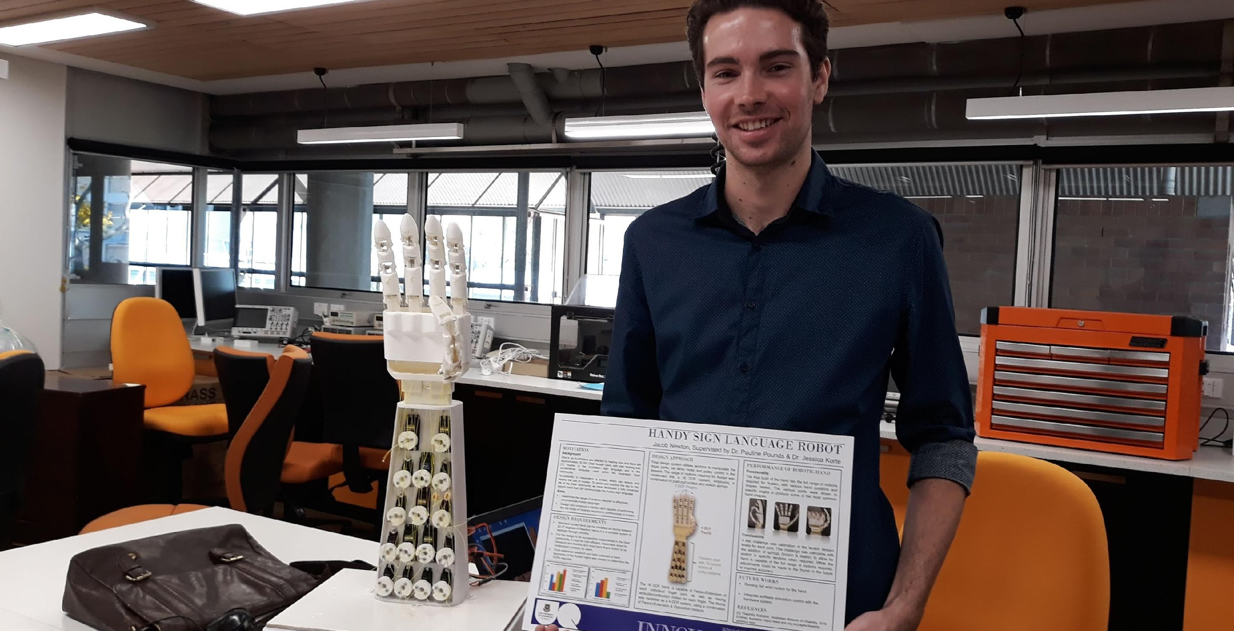
Ozzie Auslan Robot
Dr Jessica Korte, UQ
Dr Pauline Pounds, UQ
Available for student projects

Slide 52
Lecture Summary
What did you think was the most important lesson?
What was the most interesting thing?
What questions do you still have?

